Slide 1
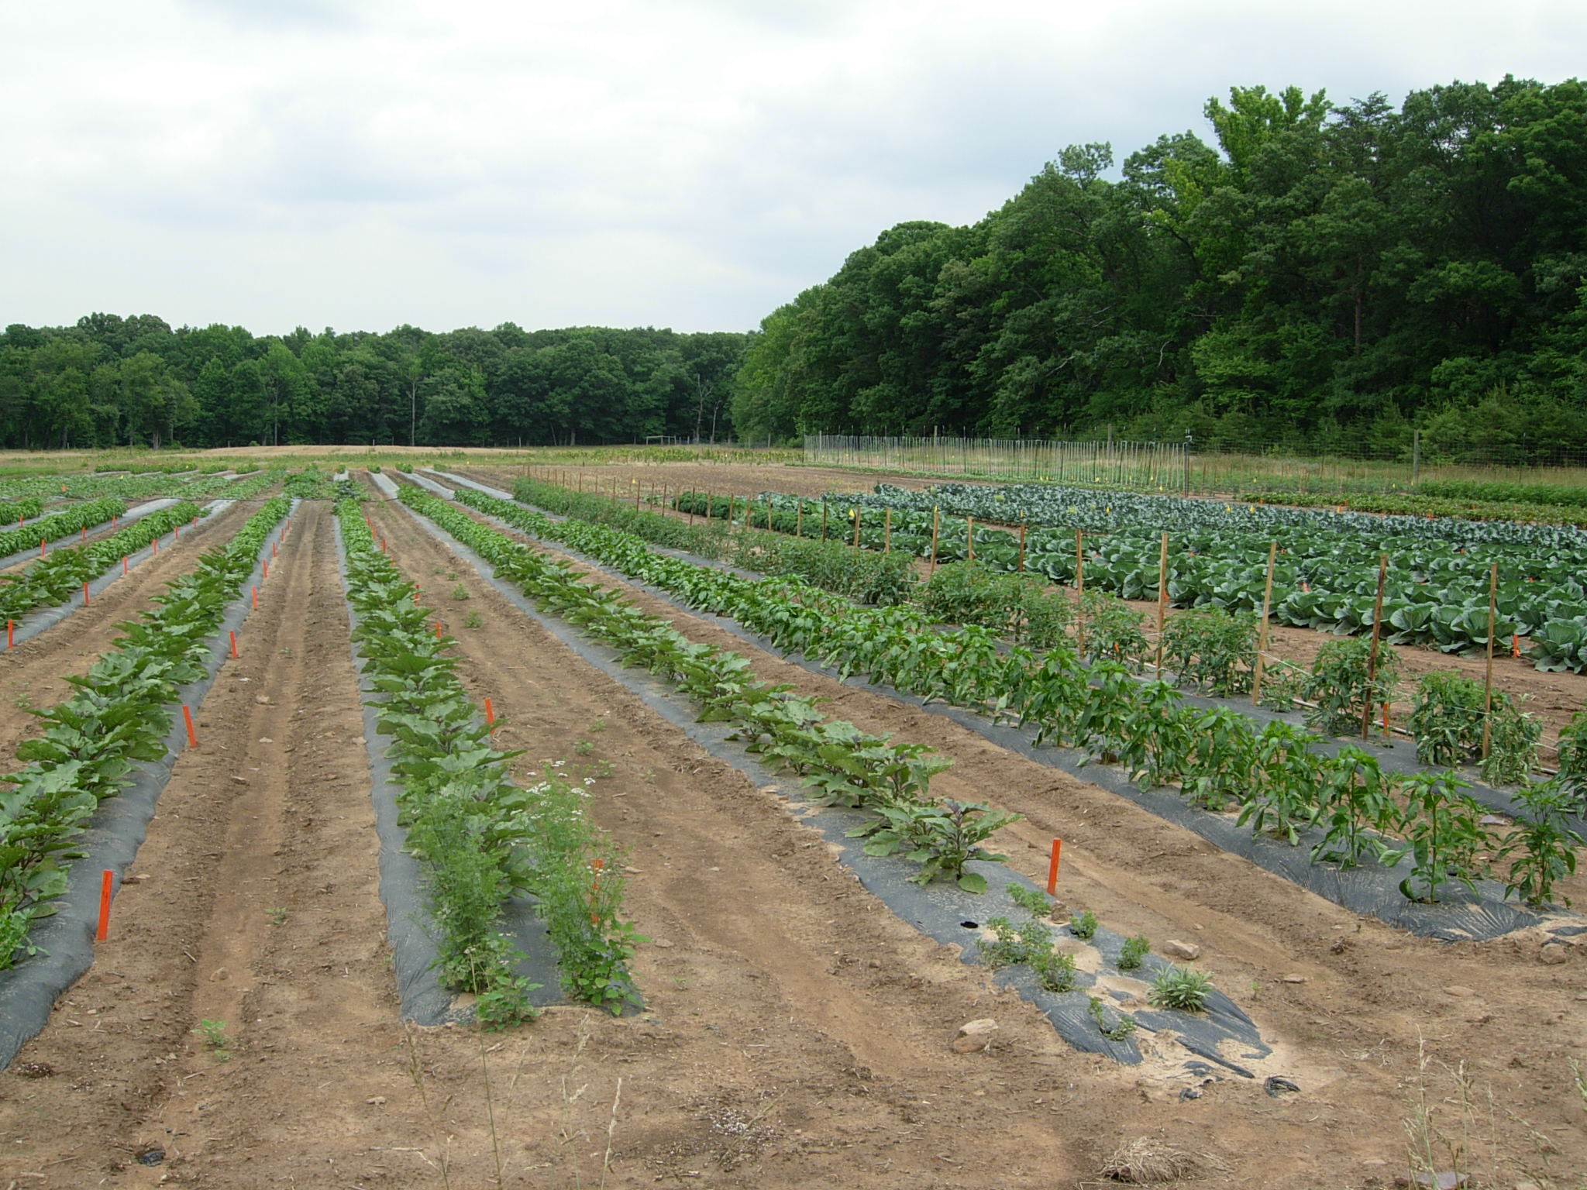
Organic Insecticides:
What works and what Doesn’t
Galen Dively and Terry Patton
Department of Entomology,
University of Maryland
galen@umd.edu

Slide 2
National Organic Program Code 205.206 Crop pest, weed, and disease management practice standard.
(e) When the practices provided for in paragraphs (a) through (d) of this section are insufficient to prevent or control crop pests, weeds, and diseases, a biological or botanical substance or a substance included on the National List of synthetic substances allowed for use in organic crop production may be applied to prevent, suppress, or control pests, weeds, or diseases.
Provided, the conditions for using the substance are documented in the organic system plan.
Used as a pest management solution of last resort.
Notes:
Nearly 9,000 certified organic operations in the US.
4 million acres under organic production – of which about ½ is cropland and rest if pasture/grassland
200,000 acres of veg and fruit crops, of which 75% is located in CA, OR, and WA.
Most operations in the East are <10 acres.

Slide 3
Insect/Disease Control Products Approved for Organic Production
Bacillus thuringiensis - 20
Biopesticides - 12
Biofungicides – 23
Copper Products – 15
Mineral Dusts – 3
Ferric Phosphate – 11
Garlic Products – 6
Limonene – 6
Neem Products – 39
Nematicides – 8
Oils – 22
Pheromones – 22
Plant Pesticides – 27
Pyrethrum – 7
Soaps – 45
Spinosad – 21
Sulfur Products – 21
Virus Sprays – 4
**Organic Materials Review Institute (OMRI) list 46 generic categories and 329 products that are certified organic under the USDA National Organic Program.
Notes:
244 insect/disease control products that have been deemed by OMRI (Organic Materials Review Institute) to be consistent with the USDA-National Organic Program rules.
25 generic categories with products used in pest management.
No recent survey of how much insecticides are used and what products

Slide 4
Insect/Disease Control Products Approved for Organic Production
Bacillus thuringiensis - 20
Biopesticides - 12
BioFungicides – 23
Copper Products – 15
Mineral Dusts – 3
Ferric Phosphate – 11
Garlic Products – 6
Limonene – 6
Neem Products – 39
Nematicides – 8
Oils – 22
Pheromones – 22
Plant Pesticides – 27
Pyrethrum – 7
Soaps – 45
Spinosad – 21
Sulfur Products – 21
Virus Sprays – 4
**Organic Materials Review Institute (OMRI) lists about 240 insect control products that are certified organic under the USDA National Organic Program.
Notes:
46 different categories of products

Slide 5
Problems and Limitations with Organic Insecticides
  Short-lived
  Require frequent applications
  Require complete coverage and precise timing
  No systemic activity

Slide 6
Problems and Limitations with Organic Insecticides
  Short-lived
  Require frequent applications
  Require complete coverage and precise timing
  No systemic activity
  Not available in small units
  Short shelf life
  May lack registration status

Slide 7
Problems and Limitations with Organic Insecticides
  Relatively short-lived
  Require frequent applications
  Require complete coverage and precise timing
  No systemic activity
  Not available in small units
  Short shelf life
  May lack registration status
  Most products are “restricted”
  Expensive
  Lack efficacy information

Slide 8
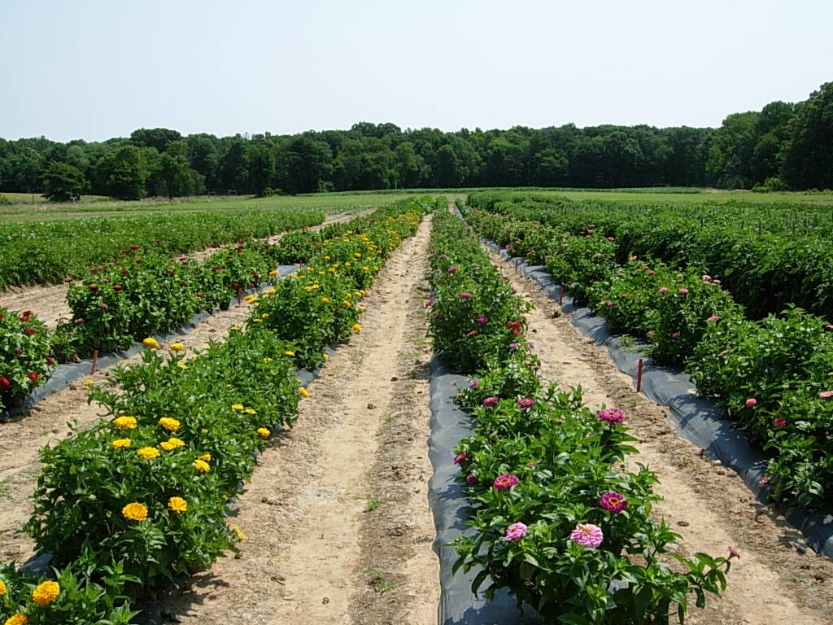
2002-14 Field Research with MGK Co., Dow AgroSciences, Certis USA, Marrone BioInnovations, others.
Evaluate efficacy, rates, and timing of registered and experimental organic insecticides
Conducted over 174 trials (6960 plots) on 22 different crop/pest systems

Slide 9
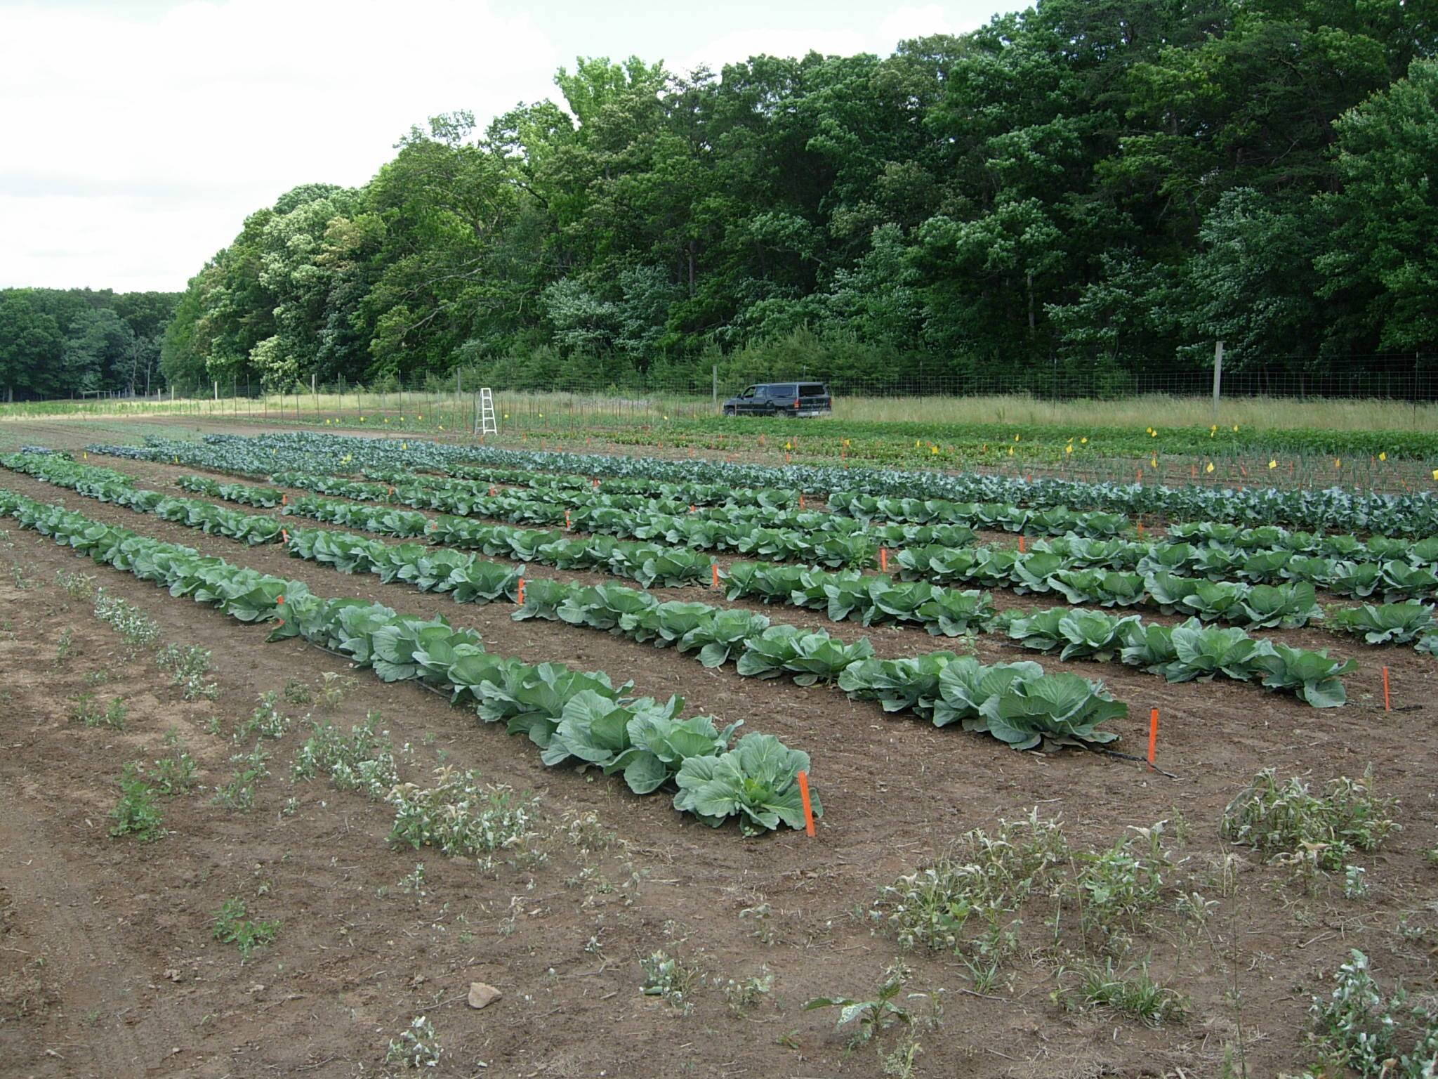
1) alfalfa – alfalfa weevil, pea aphid;
2) wheat – cereal leaf beetle;
3) potato – Colorado potato beetle, European corn borer;
4) spring-planted cabbage – cabbageworms;
5) tomato – stinkbug, fruitworms, aphids;
6) eggplant – flea beetles, Colorado potato beetle;
7) onion – thrips;
8) potato – potato leafhopper;
9) cucumber – spotted and striped cucumber beetles;
10) alfalfa – potato leafhopper;
11) spring collards – cabbageworms and flea beetles;
12) sweet corn – corn earworm, European corn borer (whorl infestations);
13) zucchini squash – squash vine borer, squash bug;
14) zinnias (cut flowers) – thrips, leafhoppers, plant bugs and beneficial insects;
15) swiss chard – leafhoppers, leafhoppers, plant bugs and beneficial insects;
16) beets - leafhoppers, plant bugs and beneficial insects;
17) basil - Japanese beetle, beneficial insects;
18) sweet corn – corn earworm and European corn borer (ear infestations);
19) green beans – Mexican bean beetle, potato leafhopper;
20) fall collards – whiteflies and aphids;
21) fall cabbage and broccoli – cabbageworms, whiteflies, aphids, harlequin bugs;
22) pepper – stinkbugs, fruitworms;

Slide 10
Mineral Dusts:
Surround WP – 95% kaolin. Engelhard Corp.
Diatect V – 82.5% silicon dioxide, 0.5% pyrethrins. Diatect International
Sulfur- 92 % Sulfur. United Phosphorus, Inc.
Botanicals:
PyGanic EC 1.4 - pyrethrum. MGK Co.
Trilogy – 70% extract of neem oil. Certis USA.
Neemix 4.5 – 4.5% azadirachtin. Certis USA.
Garlic Barrier – 99.3% pure garlic extract. Garlic Research Labs.
Hot Pepper Wax - capsaicin extract from cayenne pepper. Hot Pepper Wax, Inc.
Azera - pyrethrum (1.4%) and azadirachtin (1.2%). MGK Co.
Oroboost - 13.58% citrus oil. Oro Agri, Inc.
Ecotec - 10% rosemary oil, 2% peppermint oil. Brandt Consolidated
Ecotrol G - 2% clove oil, .66% thyme oil, 1% cinnamon oil. EcoSmart Technologies Aza-Direct - 1.2% azadirachtin. Gowan Company
Veritran D - 0.2% sabadilla alkaloids. MGK Co.

Slide 11
Fermentation Products:
Entrust 80W – 80% spinosad, fermentation metabolite of the actinomycete, Saccharopolyspora spinosa. Dow AgroSciences
Deliver – 18% Bacillus thuringiensis subs kurstaki. Certis USA.
Javelin WG – 7.5% Bacillus thuringiensis subs kurstaki. Certis USA.
Agree WG – 3.8% Bacillus thuringiensis subs aizawai Strain GC-91, Certis USA.
Mycotrol O - 10.9% Bearveria bassiana Strain GHA. BioWorks, Inc.
MBI-203 (Grandevo) - 94.5% Chromobacterium subtsugae strain URAA4-1. Marrone Bio Innovations
MBI-206 (Venerate) – Burkholdeia. Marrone Bio Innovations
PFR-97 – 20% Isaria fumosorosea Apopka Strain 97. Certis USA
Gemstar – 0.64% Polyhedral occlusion bodies of the nuclear polyhedrosis virus of
Helicoverpa zea (Certis USA)
Soaps and Oils:
M-pede – 49% potassium salts of fatty acid (Dow AgroSciences)
Ultra fine oil - 98.8% paraffinic oil. Whitmire Micro-Gen Research Laboratories

Slide 12
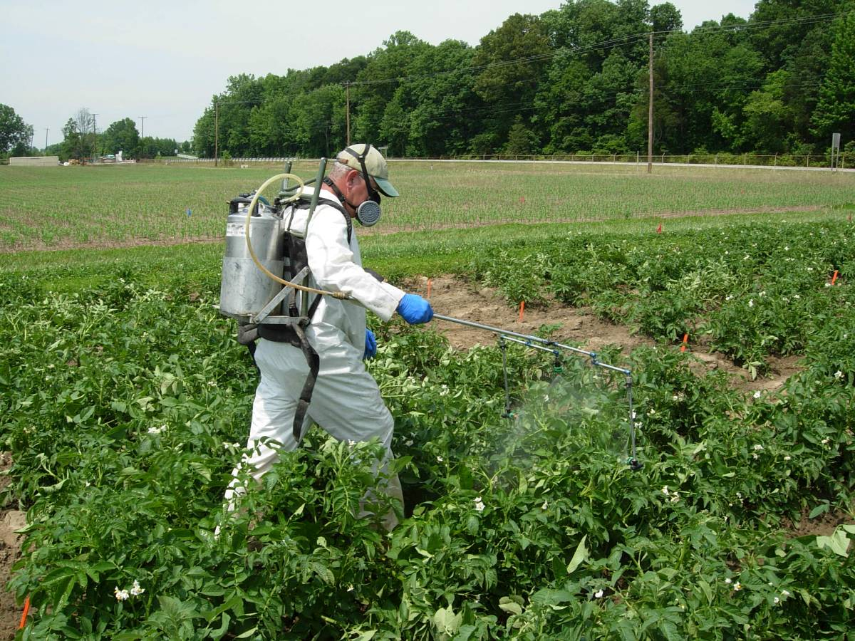
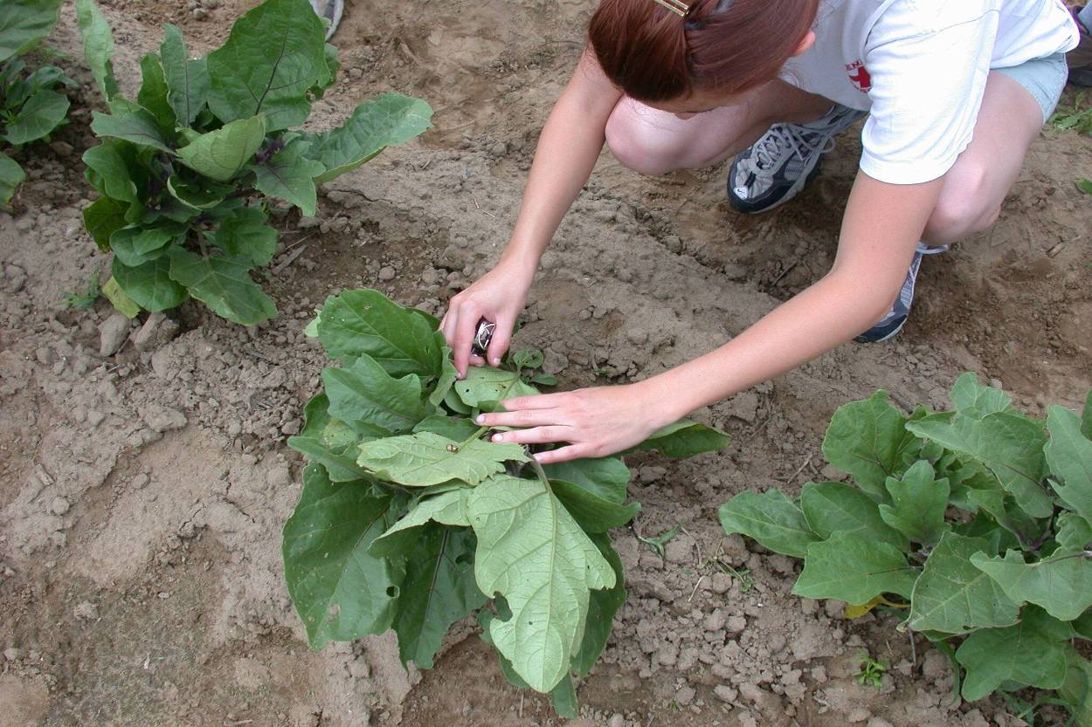
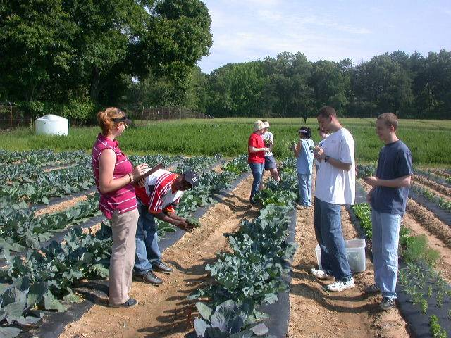
Plots treated 2-6 times every 7 days, depending on pest complex.
Treatments applied with CO₂ backpack sprayer, delivering 20-40 gal/acre at 40 psi.
2 and 6 day post-treatment counts.
Ratings of plant injury and marketable yield.

Slide 13
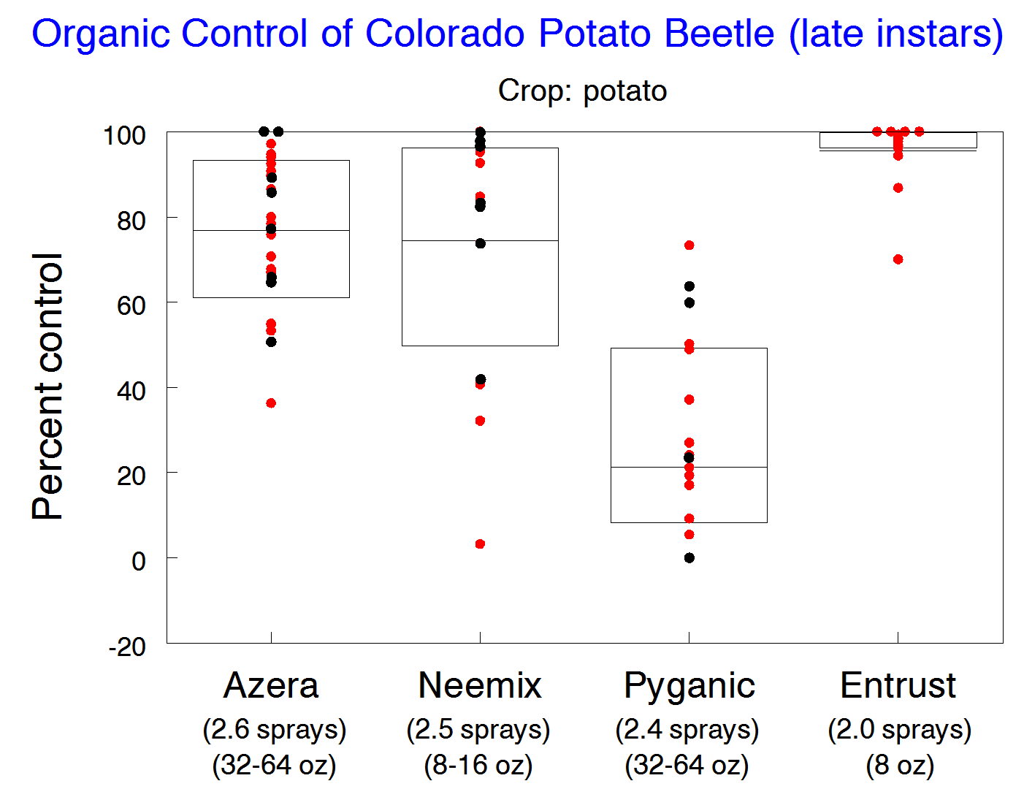
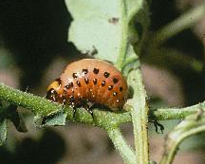
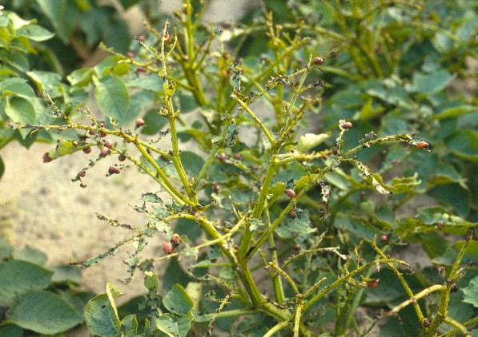

Slide 14
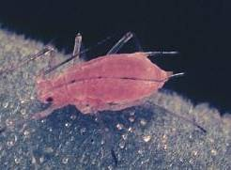
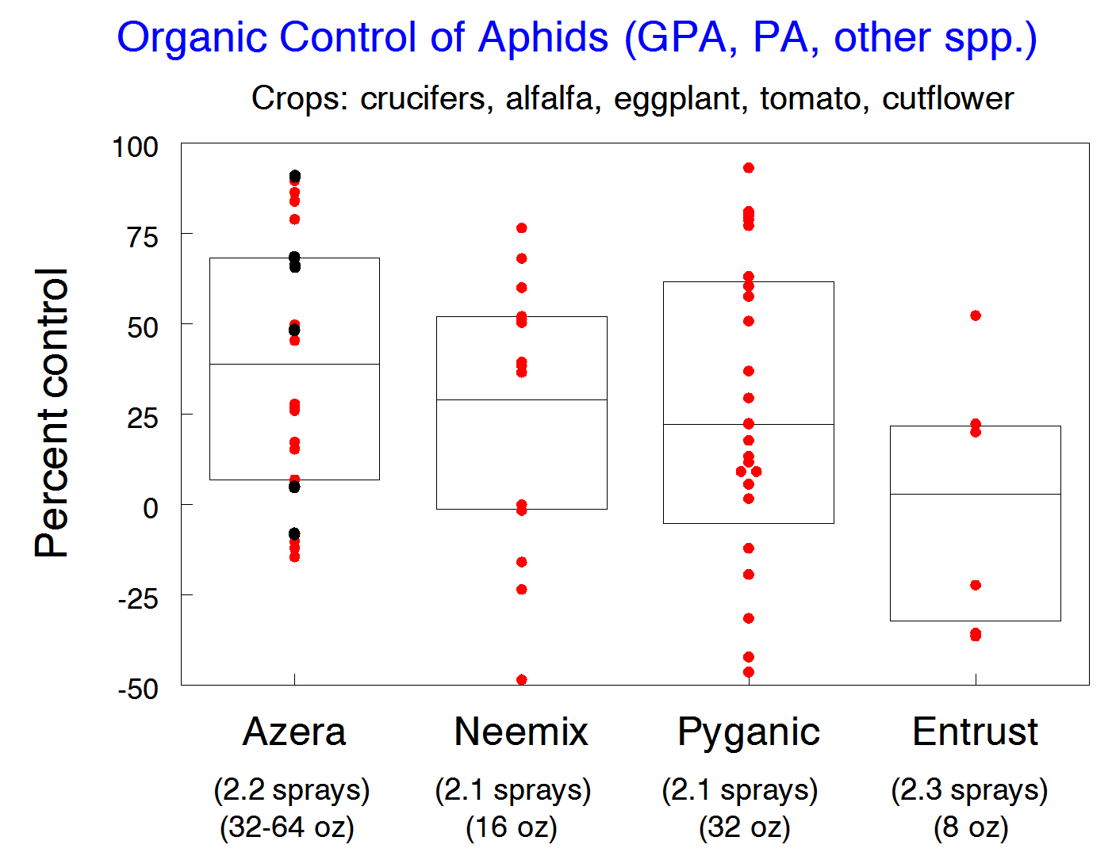
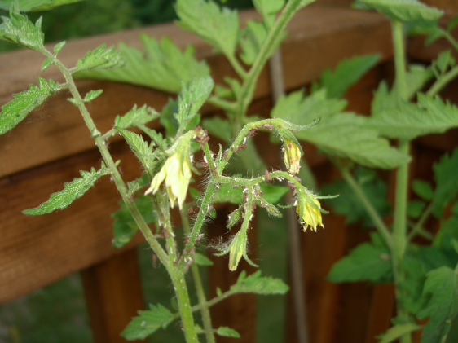

Slide 15
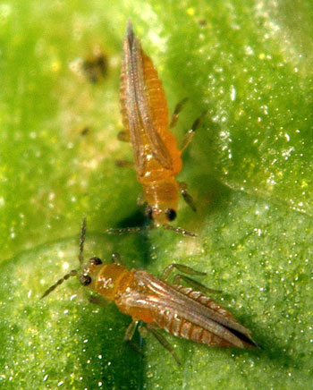
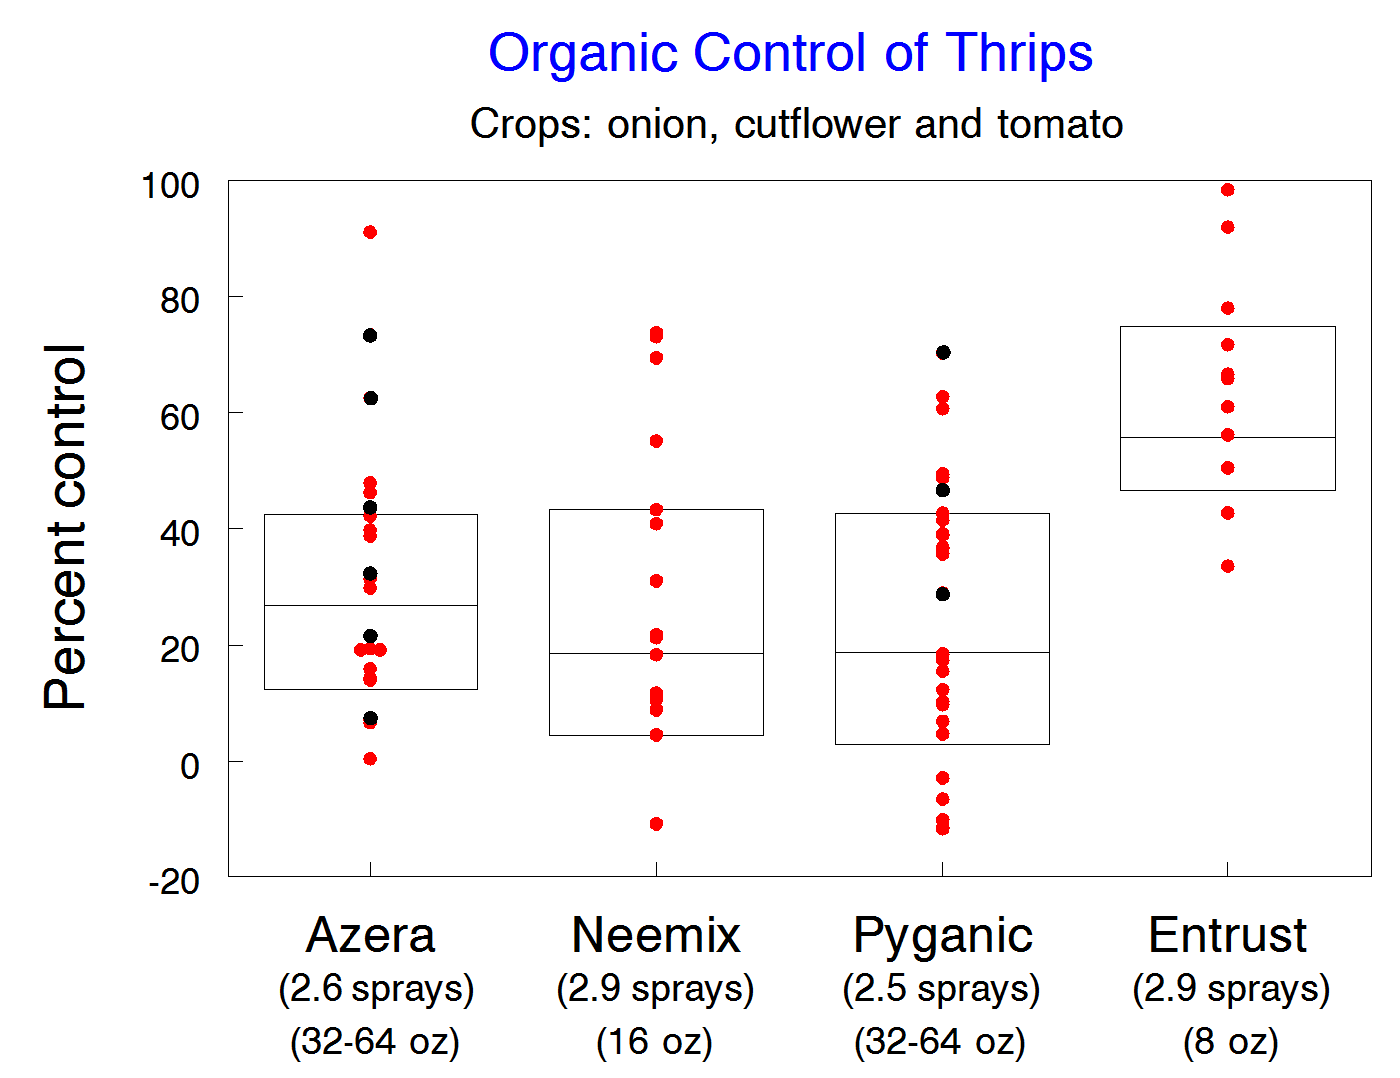
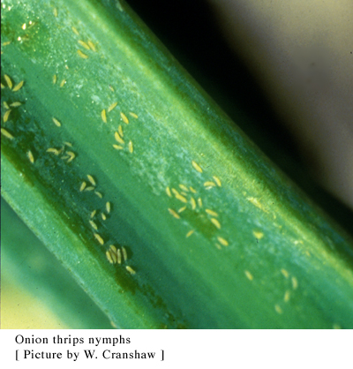

Slide 16
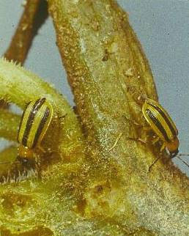
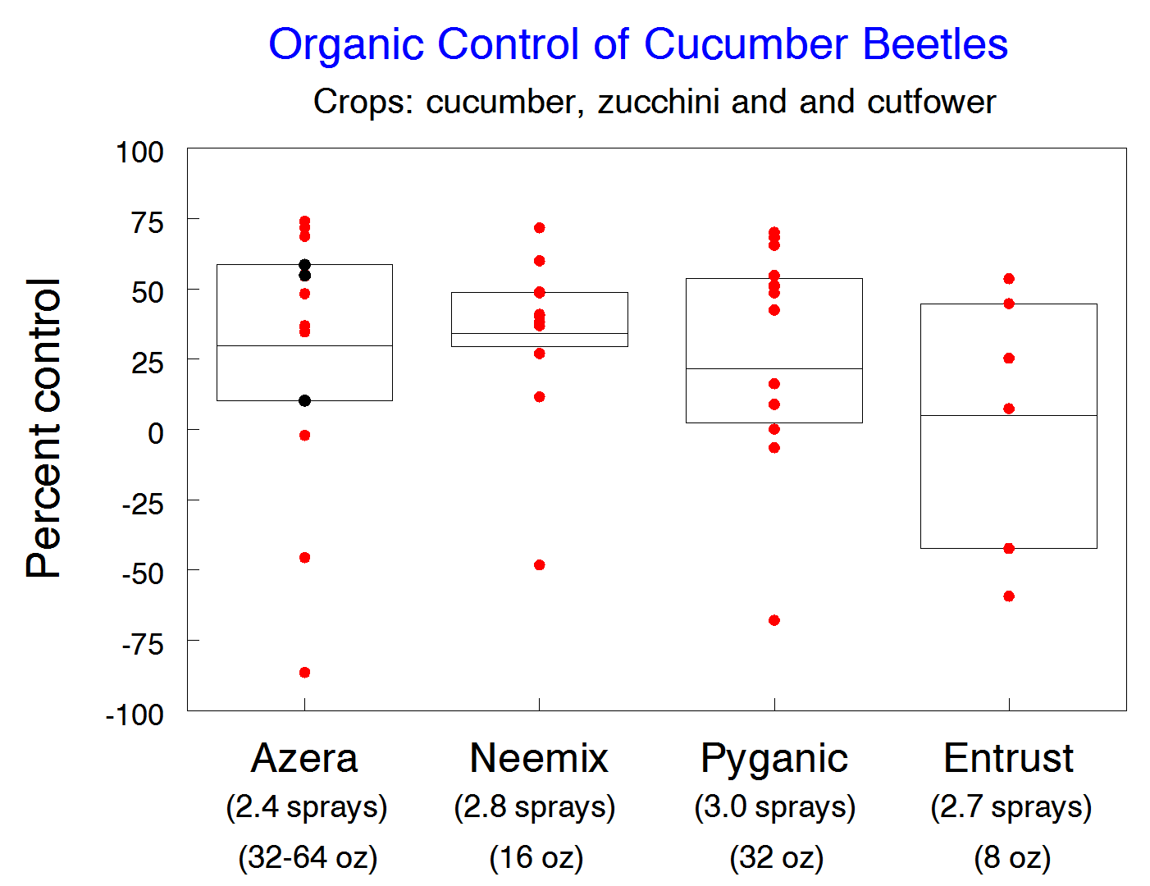
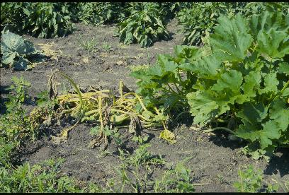

Slide 17
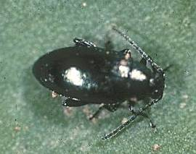
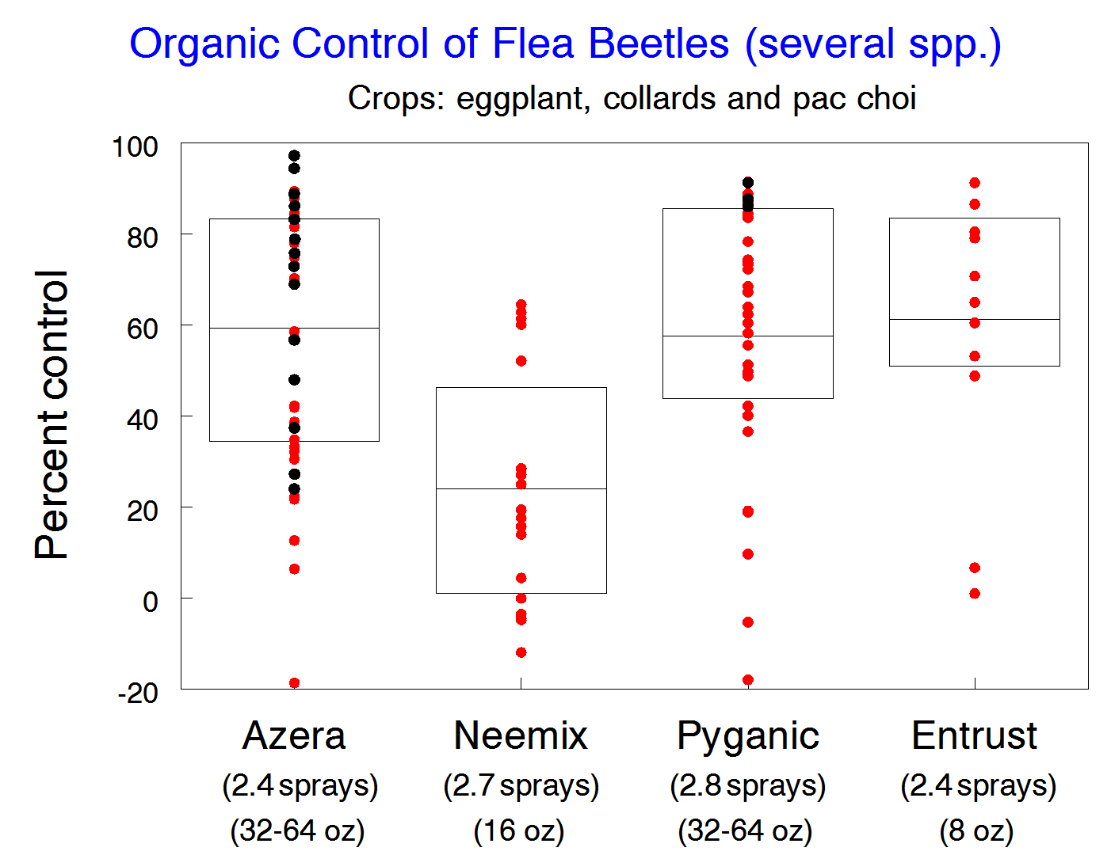
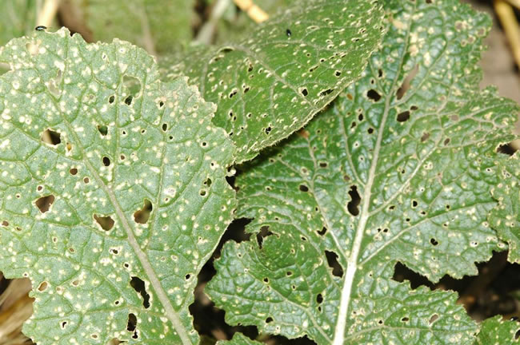

Slide 18
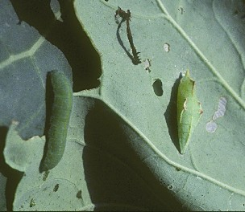
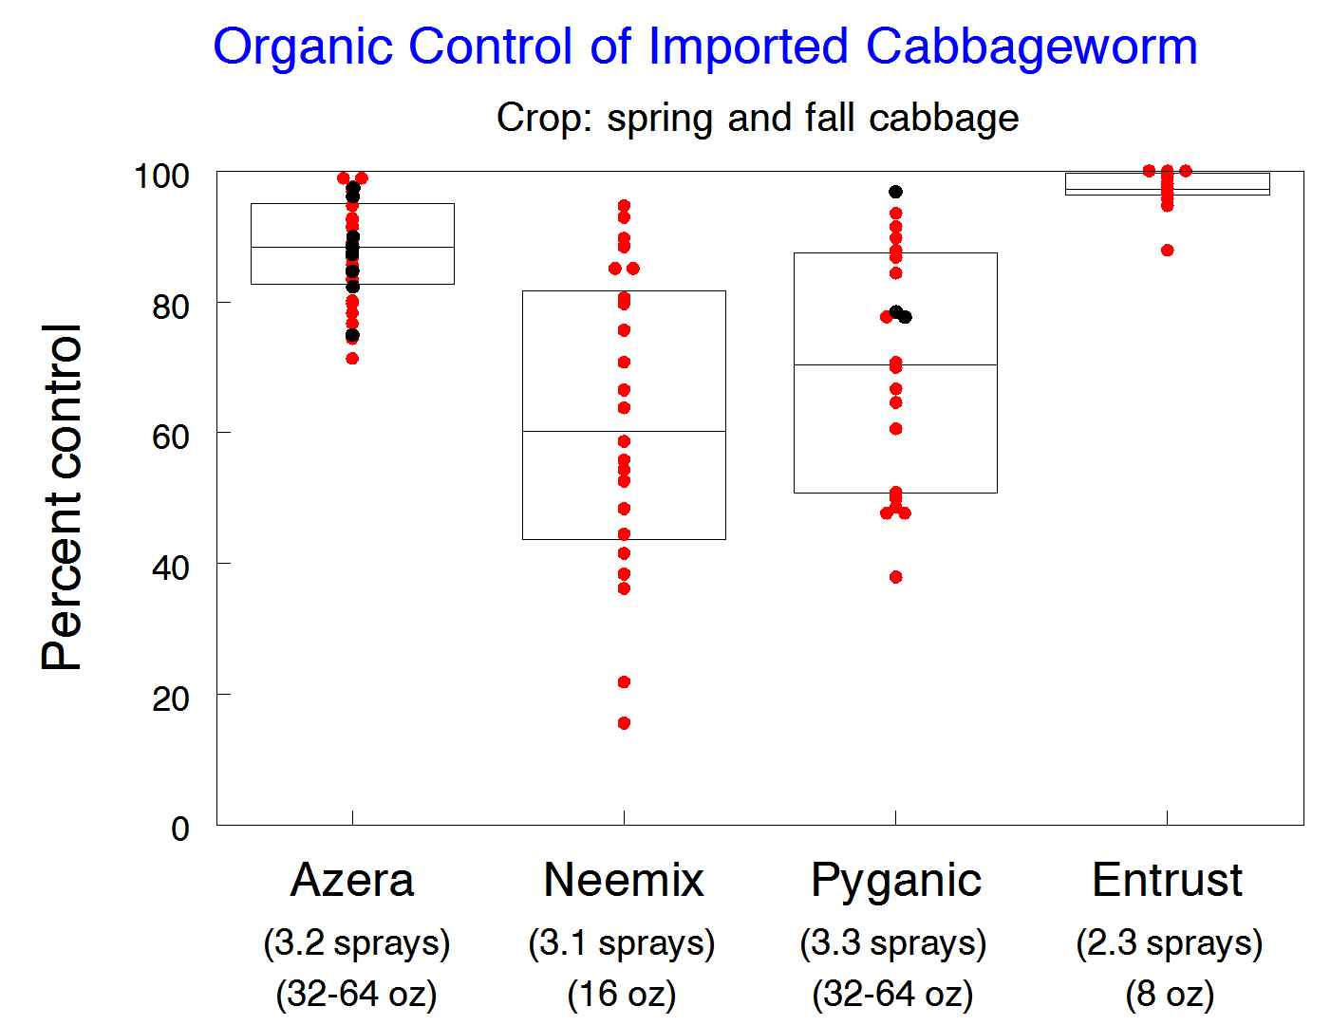
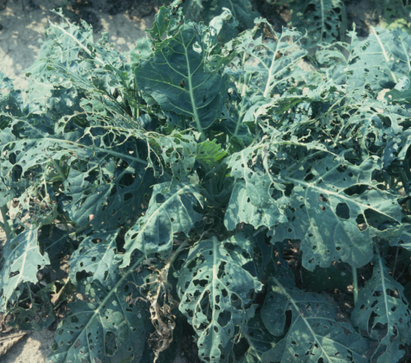

Slide 19
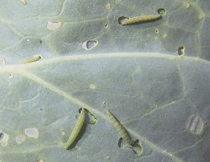
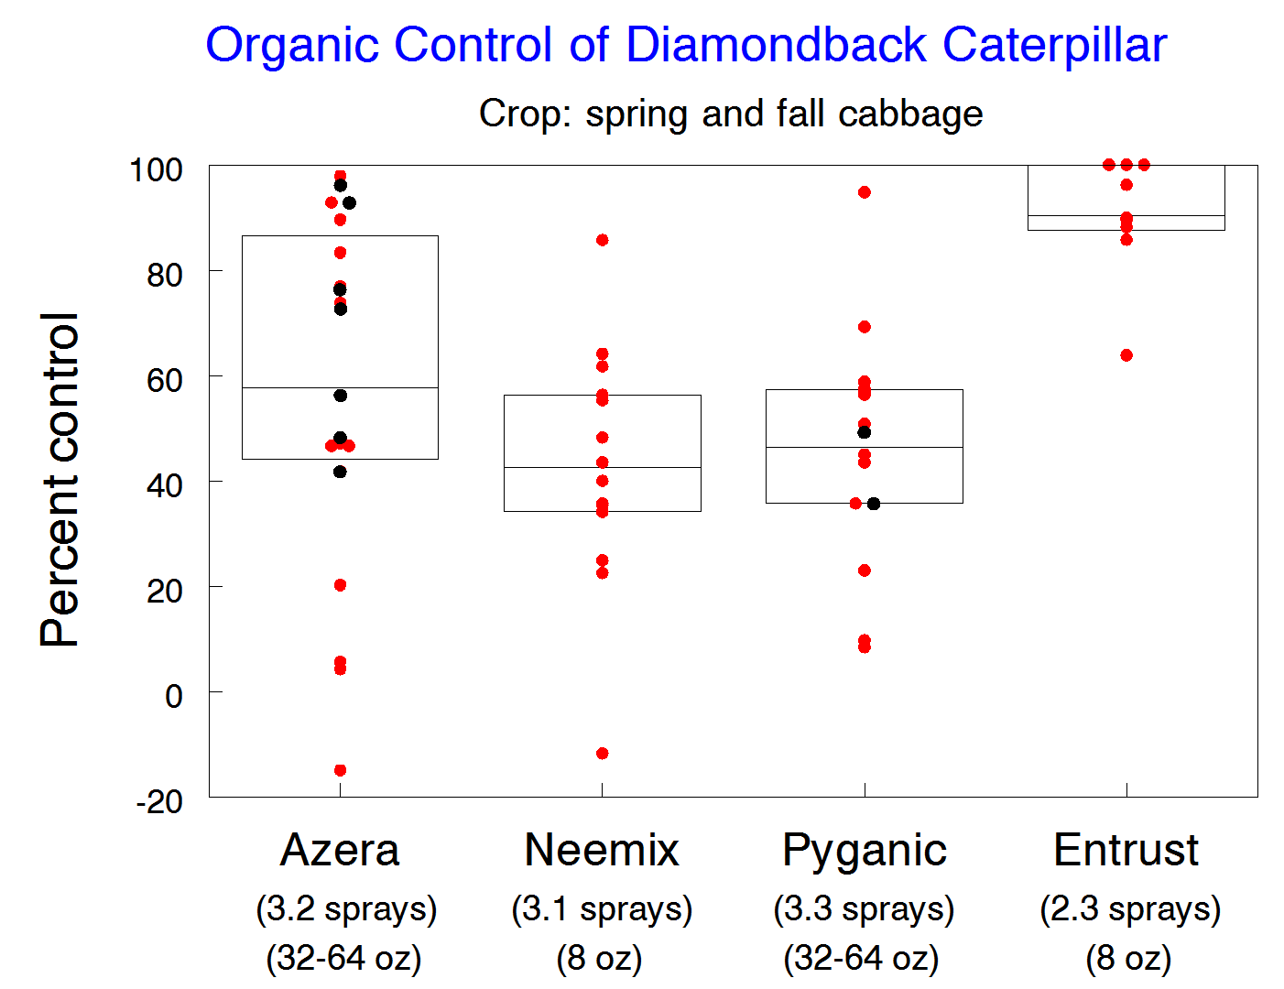
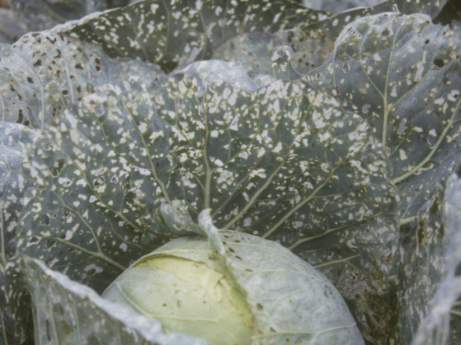

Slide 20
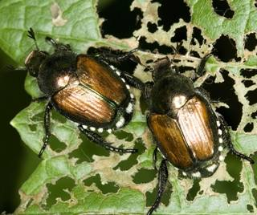
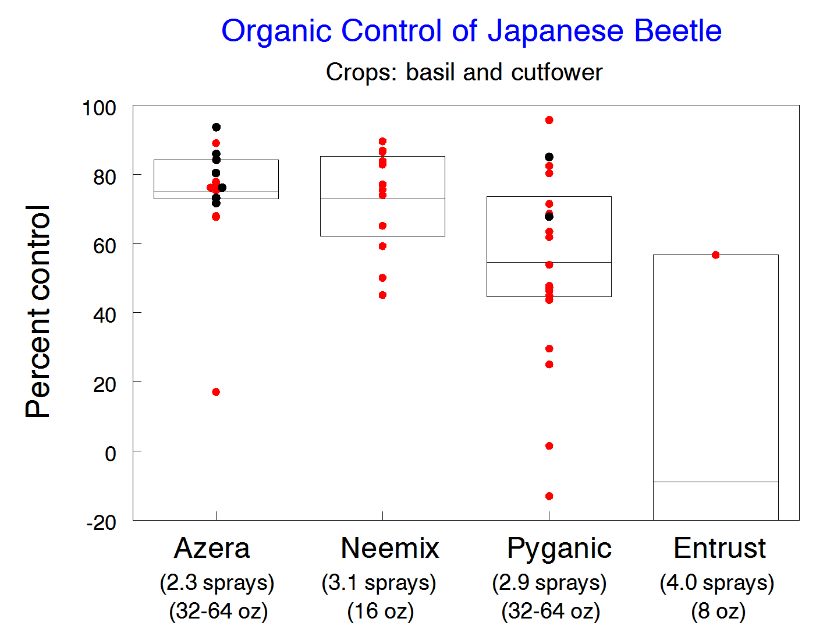
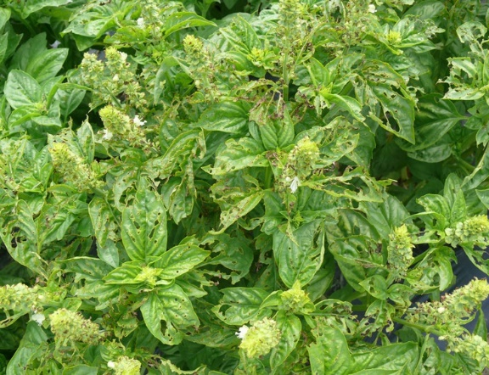

Slide 21
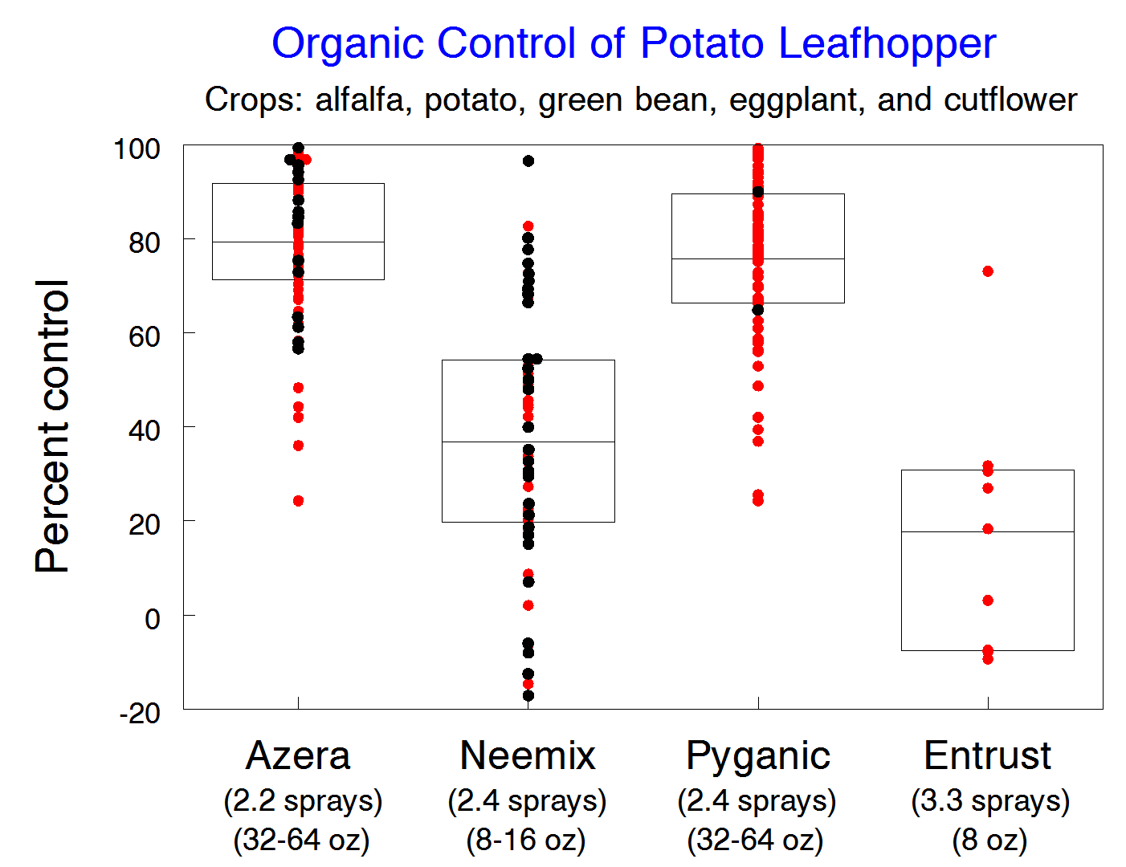
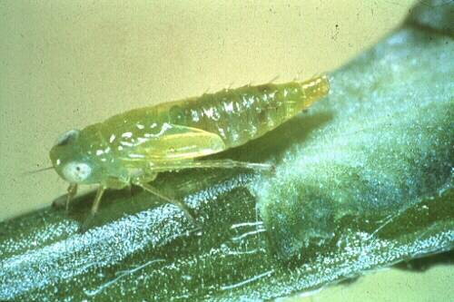
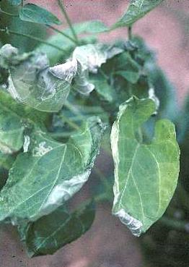

Slide 22
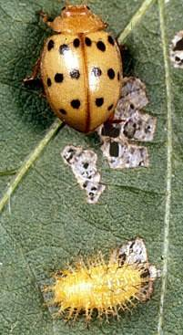
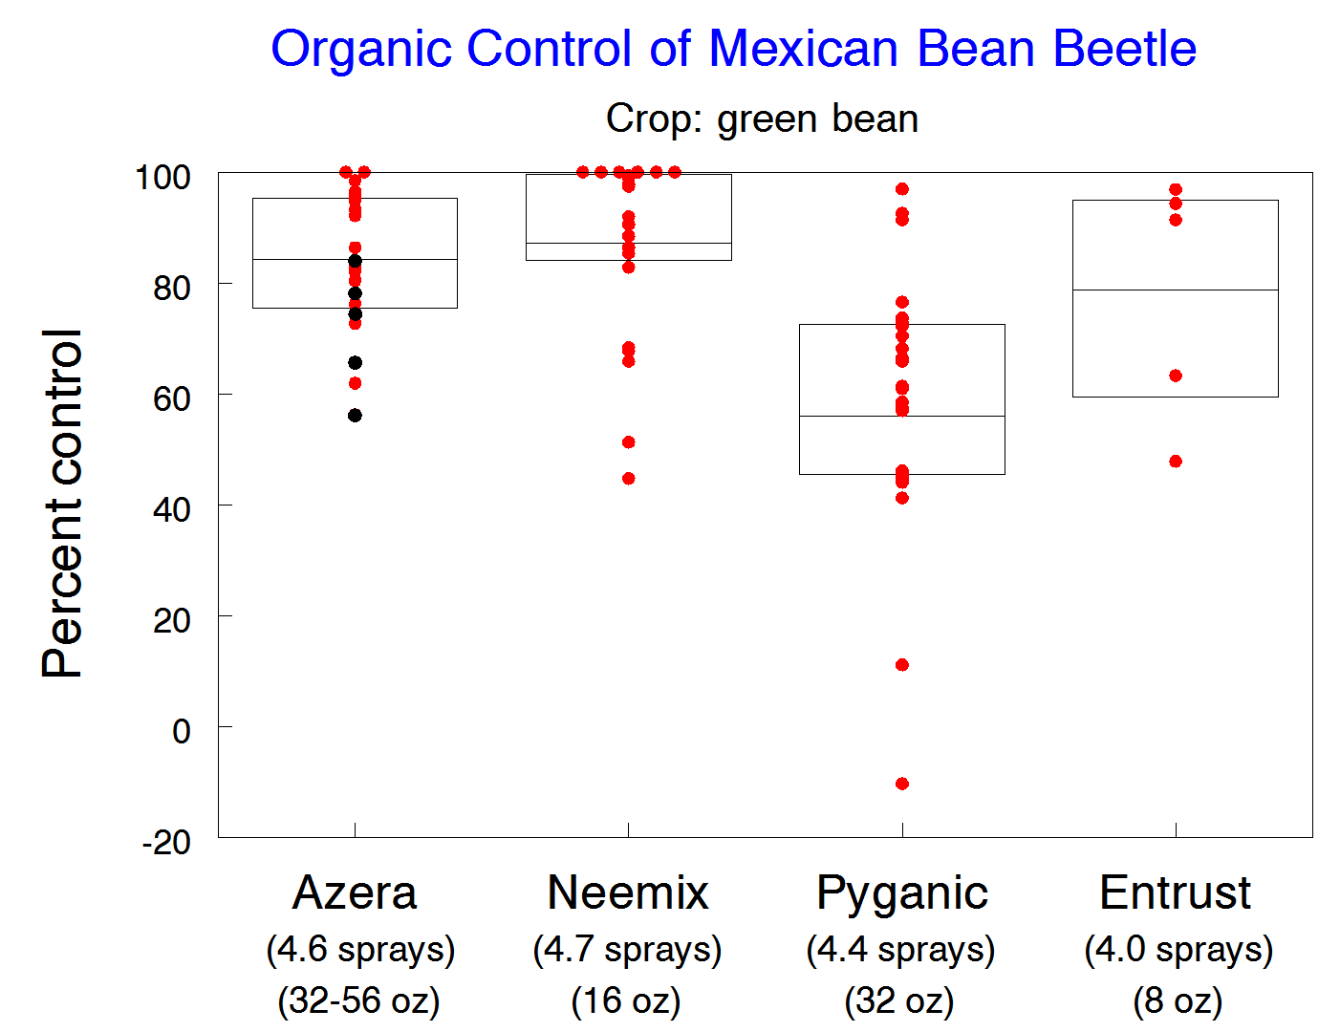
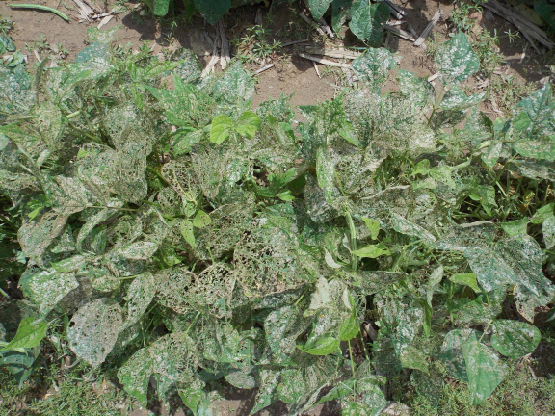

Slide 23
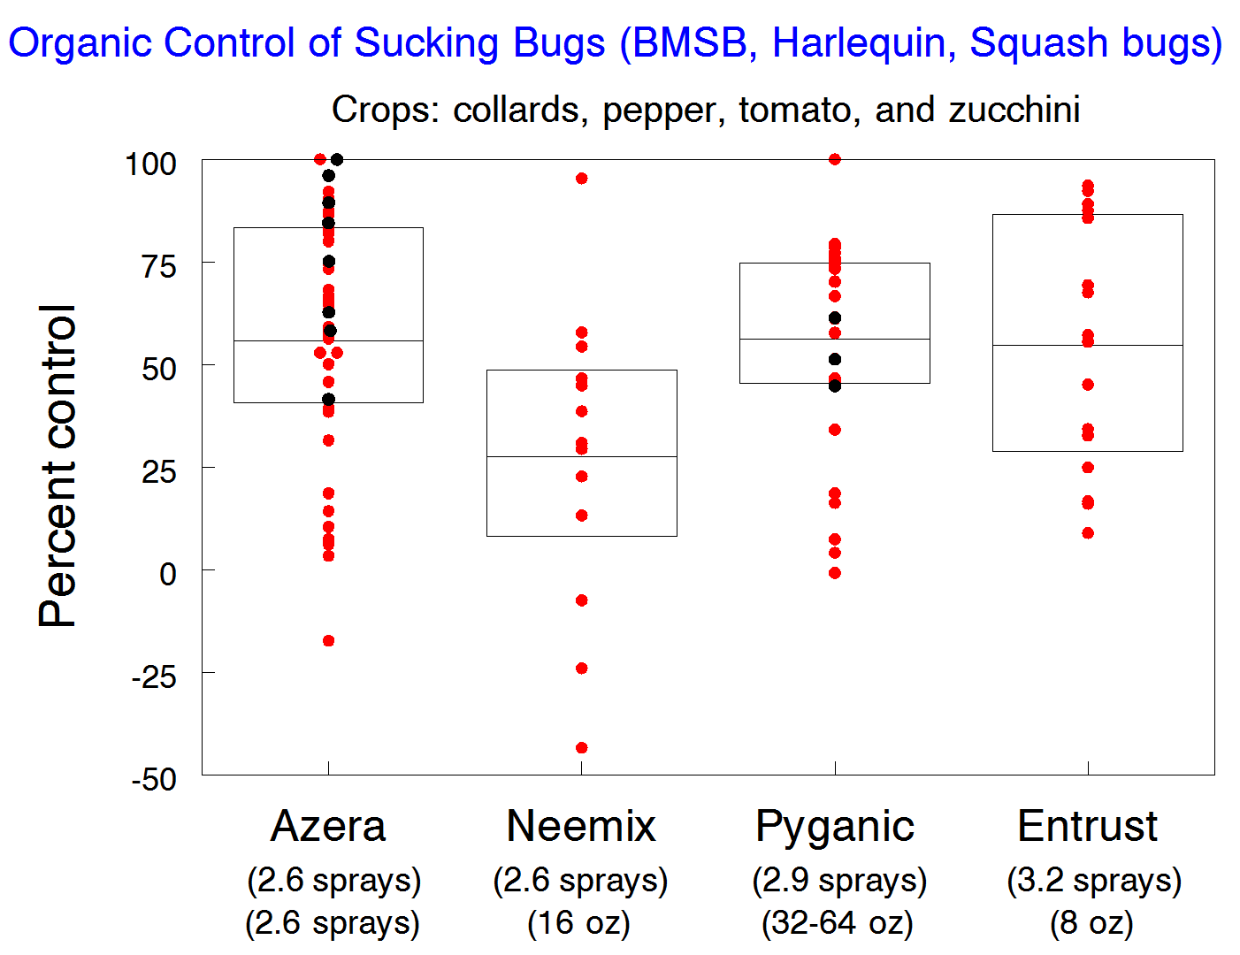
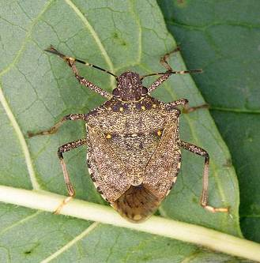
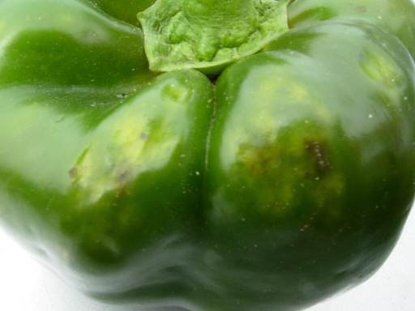
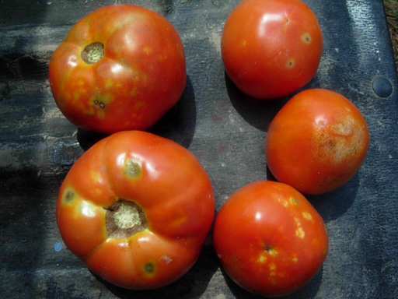

Slide 24
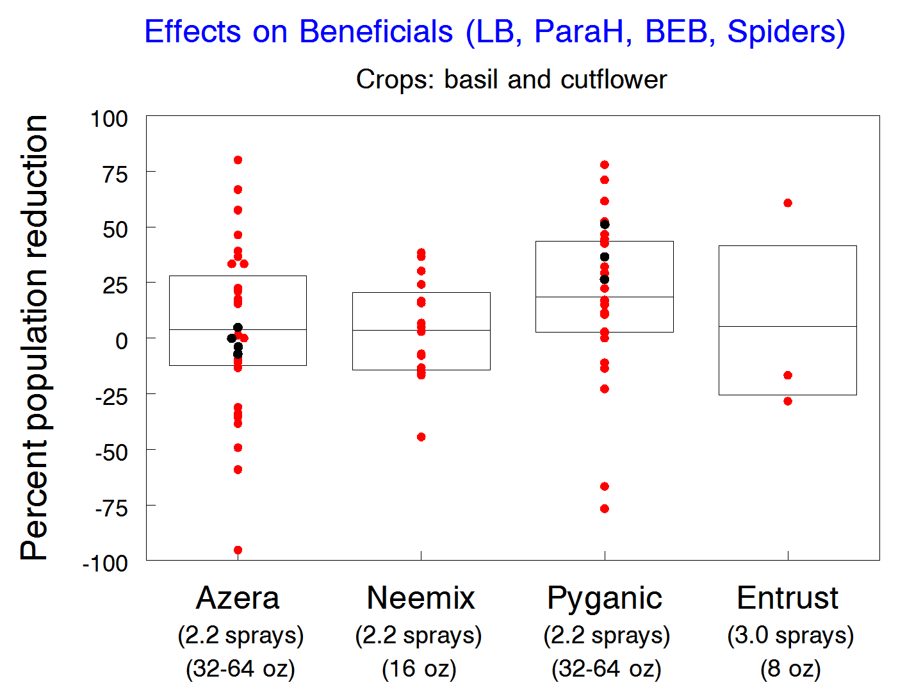
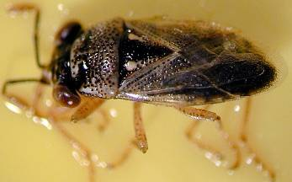
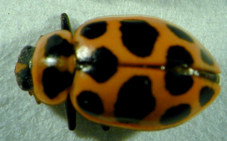
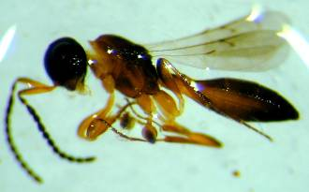
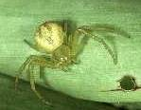

Slide 25
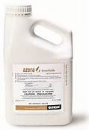
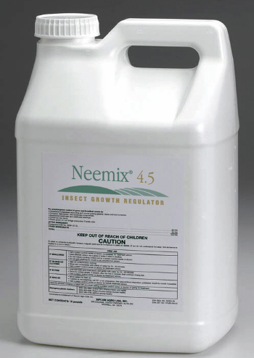
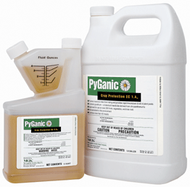
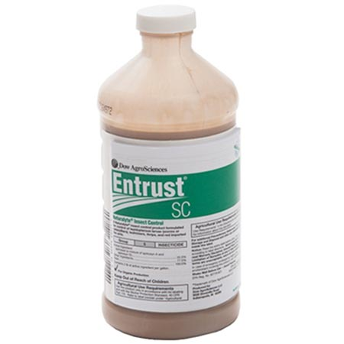
Azera
Neemix
Pyganic
Entrust
Overall % Control
57%
36%
44%
51%
Aphids
Thrips
Potato beetles
Cucumber beetles
Flea beetles
Imp. cabbageworms
Dback larvae
Japanese beetles
Leafhoppers
M. Bean beetles
Sucking bugs
P-F
F
G-VG
F
F-G
VG
F-G
G
G-VG
VG
F-G
P-F
F
G
F
P
G
F
G
P-F
VG
F
P-F
F
F
F
F-G
G
F
F-G
G-VG
F-G
F-G
P
G
VG
P
G
VG
VG
P
P
G
F-G

Slide 26
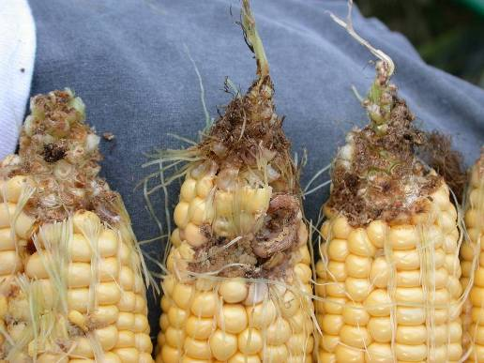
Organic Insecticide Options for Corn Earworm in Sweet Corn
Effects of organic insecticides on ear-invading insects in sweet corn. Beltsville Research and Education Center. UMd
Treatments | Rate/acre | Percent damaged ears |  | Percent damaged by earworm |  | Percent damaged by corn borers |  | Percent damaged by sap beetles |  | Percent damaged by fall armyworms
Neemix | 32 oz | 96.5 | a | 93.0 | a | 2.5 | a | 1.8 | a | 0.5 | a
Pyganic | 32 oz | 96.0 | a | 94.5 | a | 3.5 | a | 0.0 | a | 1.5 | a
Entrust | 36 g | 7.0 | b | 7.0 | b | 0.5 | a | 2.0 | a | 0.0 | a
Untreated | - | 93.5 | a | 91.5 | a | 5.5 | a | 2.3 | a | 2.3 | a
**8 treatments applied every 2 days, starting at early silking

Slide 27
Organic Insecticide Options for BMSB
Most effective available insecticides (% control):
    Azera (74-84%)
    Azera + M-Pede (65-90%)
    Entrust (68-89%)
    Entrust + M-Pede (68-92%)
    PyGanic (58-79%)
    Veratran D - sabadilla alkaloids (40-90%)
Only effective against nymphs and relatively poor control of adults.
Control is expensive, given that two or three applications of product mixtures may be needed.

Slide 28




Thanks to:
MGK Co.
Certis USA
DowAgroScience
MD Dept of Agriculture
IR4 Minor Use Program

